Slide 1

Category A: Cost & Savings
DY10R2 Reporting
Joint RHP 9, 10, & 18 ]
Virtual Learning Collaborative
Thursday, August 19, 2021
9:00 – 10:30 am

Slide 2
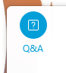
Housekeeping
All attendees are on mute.
Use the Q & A section to ask questions at anytime during the session.
This session is being recorded.
All materials from this event will be made available after the event. Your Anchor will let you know when it is available.
Notes:
Good afternoon and thank you for joining us today! I’m Margie Roche, the Anchor for RHP9, I am joined today as co-sponsor Anchors des Anges Cruser & Leigh Hornseby from RHP 18 and Nisha Patel from RHP 10.
Before we get started, a few housekeeping items.
All attendees are on mute.
Throughout the discussion you may submit your questions or comments in the Q & A section and we will try to answer as many as we can at the end of the panelist discussion time. If we do not get to your question, we will have a list of them and do our best to answer them in a Q&A document that will be made available after the event. There is no CHAT available during this session, if you have a question or comment you will need to use the Q & A section. If you do not see it, It can be found in your icon tray. This is located at the bottom of your screen and can be found by hovering you mouse pointer near the bottom of the screen. Once the tray pops up, click on this icon with the three dots and an additional icon pop window will appear, click on the Q&A that looks like a Question mark,. This should open the Q&A activity in your window, usually to the right of your screen.
Please use the ALL panelist selection when entering a questions so that our Question Monitor will be able to see them and direct them accordingly. If you have a question for a specific panelist, just put their name in your comments.
This session is being recorded, the recording and all materials will be made available within a few days event. Your Anchors will let you know when they are available.
If you are joining us through Audio only, or have not logged into Webex with your name, please send your anchor your information and let us know you attended. We will update the attendance sheets and they will be made available with the other materials.

Slide 3
Overview of Meeting
Welcome/Introductions
Brief DSRIP Reporting Updates
Category A Requirements for DY10 October Reporting
Cost & Saving Reporting Prep: What is Needed?
Walkthrough of the Draft HHSC Cost & Savings Tool
Wrap-up and Closing Remarks

Slide 4
DY10R2 Reporting – October 2021
Category A
Qualitative Questions in the online reporting CAT A tab
Complete Cost & Savings Analysis Template
CAT B
Complete your CAT B tab
CAT C
Performance Year 3 (PY3 – CY2020) Goal Achievement and Reporting Milestones
CAT D
Complete Cat D if not completed in April DY10R1
A Core Activities Template
Collaborative Participation
Alternative Payment Models Participations
DY10 CAT B – Measurement Period 10/1/20 – 9/30/21
Complete and Upload CAT C Template
Semi-Annual Reporting (SAR)
Category D Template
DY9 RM-4
DY9 AM-9.x
CAT C Related Strategies Template sent to HHSC Email (if partial/no CAT C in April)
Notes:
In the upcoming DY19R2 – October Reporting this is what Providers will be expected to report:

Slide 5
Brief DSRIP Reporting Updates
COVID-related accommodations for DY10 performance
  Category B
    No decision on allowing an increased allowable various (AV) for MLIU PPPP
    HHSC can modify AV at their discretion; continue to evaluate recent data and ongoing pandemic situation
  Category C
    Accommodations related to achievement requires CMS approval
    HHSC reviewing overall assignment of achievements for PY3; considering issues/challenges related to similar accommodations in PY4

Slide 6
Key DSRIP Related Reporting Dates
September 1: Requests for CAT B Plan Modifications due to HHSC
October 1: DY10 R2 DSRIP reporting opens
October 31: DY10 R2 DSRIP reporting closes
  Overall provider Summary – Semi Annual Report (SAR) Requirement
  Category A: Core Activities, APM participation, Learning Collaborative Participation and Cost & Savings Analysis (if valuation ≥ 1M)
  Category B: System/MLIU Population
  Category C and Category D: whatever was not reported in April – DY10R1

Slide 7

1115 Waiver Transition Update
Friday, August 13, 2021
  Court Order for CMS to respond to HHSC on DPPs
  CMS Letter to State
    Specifically, CMS has now informed Texas that:
      None of the newly proposed DY11 directed payment programs will be approved as currently submitted; and
      DSRIP can be extended for one year (DY11: October 1, 2021 through September 30, 2022) as an amendment to the existing waiver
  This is what we currently know.
  There was another court hearing on Tuesday, 8/17/21 – however, no decisions have been made. Feedback from this hearing is that HHSC is considering the options and the impacts on budget neutrality and other downstream implications.
  We are waiting on HHSC for a more formal evaluation and explanation of the letter and any other news.
Notes:
Friday, August 13, 2021
Court Order for CMS to respond to HHSC on DPPs
CMS Letter to State
Specifically, CMS has now informed Texas that:
None of the newly proposed DY11 directed payment programs will be approved as currently submitted; and
DSRIP can be extended for one year (DY11: October 1, 2021 through September 30, 2022) as an amendment to the existing waiver
This is what we currently know.
There was another court hearing on Tuesday, 8/17/21 – however, no decisions have been made. Feedback from this hearing is that HHSC is considering the options and the impacts on budget neutrality and other downstream implications.
We are waiting on HHSC for a more formal evaluation and explanation of the letter and any other news.

Slide 8
Summary of CMS Letter
CMS has indicated that at this time it cannot approve Texas’s proposed State Directed Payment Preprints (SDPs) in their current form.
  Primarily due to the fact they are unable to establish that the proposed payments meet all applicable federal statutory and regulatory requirements under the Social Security Act and implementing regulations.
  Texas must work with CMS to make suggested modifications found in the Appendix of the letter. CMS is willing to work with Texas to find an approval path for the SDP proposals.
  CMS has offered two Options to HHSC that can be found in the Appendix
    Option 1: CMS Approve the Quality Incentive Payment Program (QPP) for SFY 2022
      As currently submitted and consistent with payments amounts approved for QIPP for SFY 2021
      Revising CHIRP back to UHRIP for SFY 2022
      Withdrawing TIPPS, RAPPS, BHS preprints for SFY 2022
    Option 2: State Modifies all five (5) state directed payment preprints currently under review by CMS for SFY 2022 to be consistent with statutory and regulatory requirements addressing concerns related to:
      Aggregate Funding Amounts
      Linking Payments to Current Utilization
      Quality Improvement
      the Non-Federal Share
      the State’s Evaluation Plan
CMS has offered to address near-term stability for safety net providers through willingness to approve an amendment to the THTQIP demonstration that would extend DSRIP program for one year (through September 2022)
  In amount not to exceed the currently approved amount for the demonstration year ending September 30, 2021.
  The wording is not clear; however, it appears that we may continue to report on our existing measures and an additional 5-10 measures focused on health disparities and health equity that will be agreed upon by CMS and HHSC.
    These additional metrics
      would be aggregated at a state level based on provider reporting
      establish a baseline for measuring health disparities in the safety net for the purpose of making future improvements around equity
      would include reasonable requirements for providers, managed care plans, and/or the state to track Race, Ethnicity, Other information about beneficiaries served for the purposed of measuring health disparities
    20% of the aggregate annual DSRIP payments would be contingent on the timely and complete reporting of these metrics.
    80% - we assume, potentially will based on our existing metrics
Notes:
CMS has indicated that at this time it cannot approve Texas’s proposed State Directed Payment Preprints (SDPs) in their current form.
Primarily due to the fact they are unable to establish that the proposed payments meet all applicable federal statutory and regulatory requirements under the Social Security Act and implementing regulations.
Texas must work with CMS to make suggested modifications found in the Appendix of the letter. CMS is willing to work with Texas to find an approval path for the SDP proposals.
CMS has offered two Options to HHSC that can be found in the Appendix
Option 1: CMS Approve the Quality Incentive Payment Program (QPP) for SFY 2022
As currently submitted and consistent with payments amounts approved for QIPP for SFY 2021
Revising CHIRP back to UHRIP for SFY 2022
Withdrawing TIPPS, RAPPS, BHS preprints for SFY 2022
Option 2: State Modifies all five (5) state directed payment preprints currently under review by CMS for SFY 2022 to be consistent with statutory and regulatory requirements addressing concerns related to:
Aggregate Funding Amounts
Linking Payments to Current Utilization
Quality Improvement
the Non-Federal Share
the State’s Evaluation Plan
CMS has offered to address near-term stability for safety net providers through willingness to approve an amendment to the THTQIP demonstration that would extend DSRIP program for one year (through September 2022)
In amount not to exceed the currently approved amount for the demonstration year ending September 30, 2021.
The wording is not clear; however, it appears that we may continue to report on our existing measures and an additional 5-10 measures focused on health disparities and health equity that will be agreed upon by CMS and HHSC.
These additional metrics
would be aggregated at a state level based on provider reporting
establish a baseline for measuring health disparities in the safety net for the purpose of making future improvements around equity
would include reasonable requirements for providers, managed care plans, and/or the state to track Race, Ethnicity, Other information about beneficiaries served for the purposed of measuring health disparities
20% of the aggregate annual DSRIP payments would be contingent on the timely and complete reporting of these metrics.
80% - we assume, potentially will based on our existing metrics

Slide 9
Cost & Savings Template
Mandatory Use of HHSC Template – no alternate tools
Generic Categories for costs
  Be ready to explain where data is sourced from
  For FTE related costs – acceptable to use standard value based on job title (i.e. perhaps midpoint of the range rather than actual salary info)
Narrative response sections in template – not a separate document
Notes:
Mandatory Use of HHSC Template – no alternate tools
Generic Categories for costs
Be ready to explain where data is sourced from
For FTE related costs – acceptable to use standard value based on job title (i.e. perhaps midpoint of the range rather than actual salary info)
Narrative response sections in template – not a separate document

Slide 10
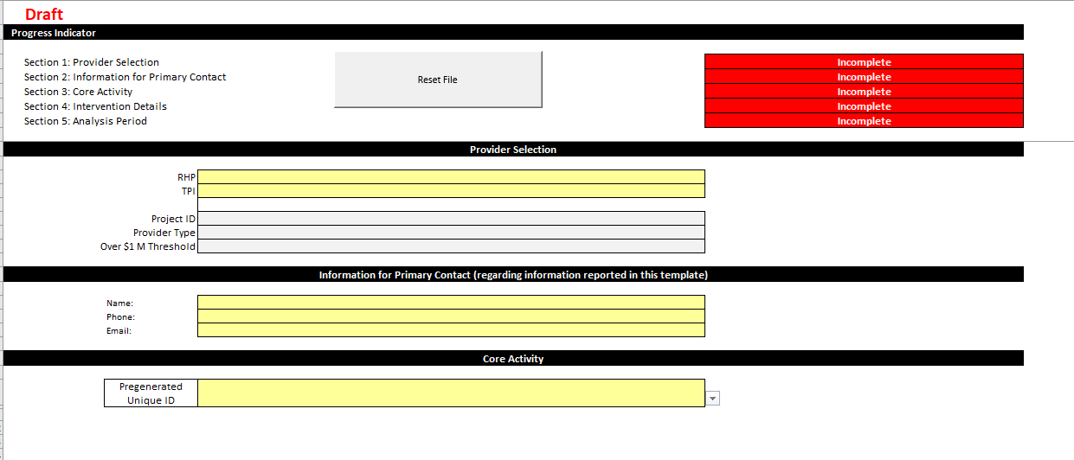
Intervention Details Tab

Slide 11
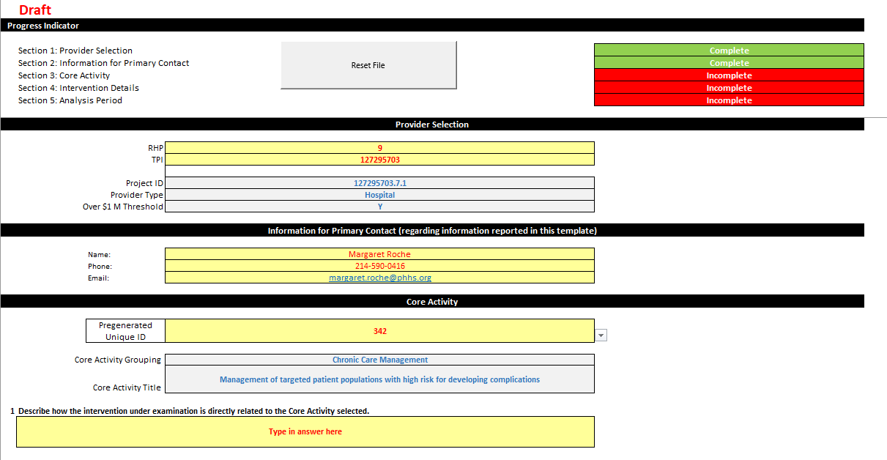
Find Your Core Activity
Complete All Yellow Fields
Pregenerated Unique ID is a list of numbers associated with your core activities, found in Column I of the DY9R2 Core Activities for DY10 Reporting.xlsx document.
Select the Pregenerated Unique ID for the Core Activity you are using for your Cost & Savings Report
Notes:
Complete All Yellow Fields
Pregenerated Unique ID is a list of numbers associated with your core activities, found in Column I of the DY9R2 Core Activities for DY10 Reporting.xlsx document.
Select the Pregenerated Unique ID for the Core Activity you are using for your Cost & Savings Report

Slide 12
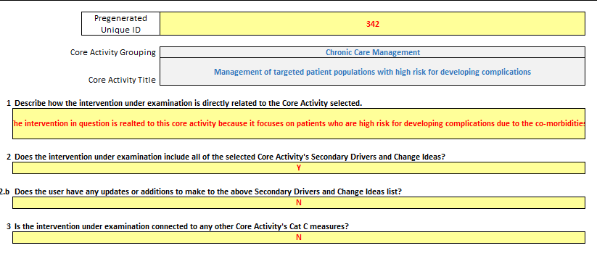
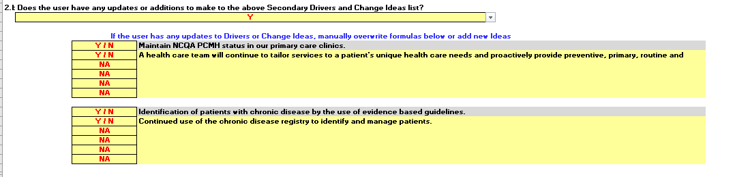
Core Activity & Intervention Questions
Complete all questions in yellow.
Each one will populate the next question or section as you complete them.
Q2:
  Yes – Pops up next question
  No – Q2.b -Offers opportunity to make changes to the currently identified Secondary Drivers and Change Ideas
Notes:
Complete all questions in yellow.
Each one will populate the next question or section as you complete them.
Q2:
Yes – Pops up next question
No – Q2.b -Offers opportunity to make changes to the currently identified Secondary Drivers and Change Ideas

Slide 13
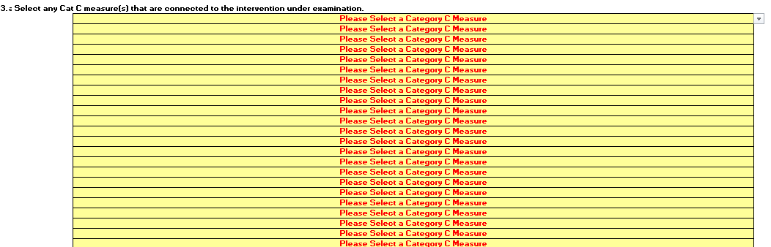

Core Activity & Intervention Questions
Question 3.a in this draft template is not working correctly.
HHSC is aware of the issue
If you answer YES – It only populates the first CAT C measure for the provider
Notes:
Question 3.a in this draft template is not working correctly.
HHSC is aware of the issue
If you answer YES – It only populates the first CAT C measure for the provider

Slide 14
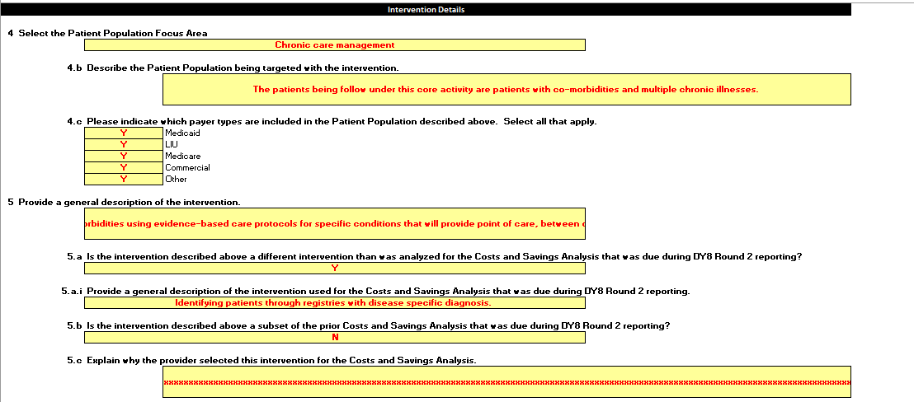
Core Activity & Intervention Questions
Q4: Complete the information on Population Focus Area. Only one choice is allowed in the drop down.
Q4.b & 4.c ask about target patient population
Q5, 5.a, 5.b & 5.c ask about the invention being assessed.
  Responses to each question fires a corresponding qualitative response
Notes:
Q4: Complete the information on Population Focus Area. Only one choice is allowed in the drop down.
Q4.b & 4.c ask about target patient population
Q5, 5.a, 5.b & 5.c ask about the invention being assessed.
Responses to each question fires a corresponding qualitative response

Slide 15
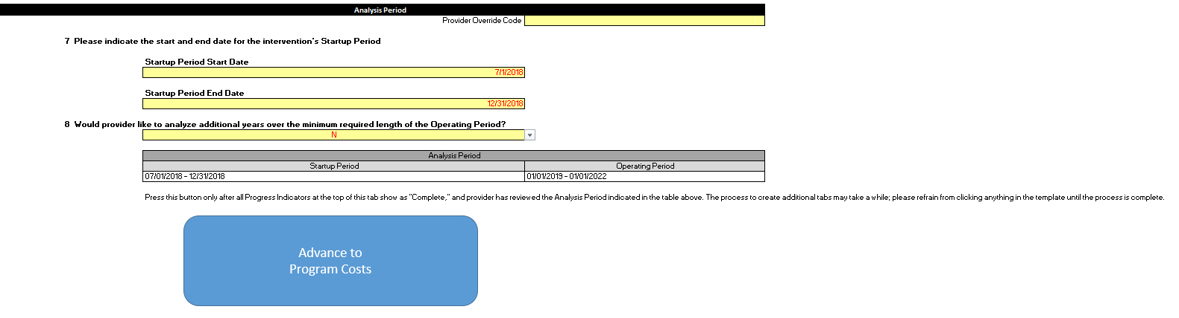
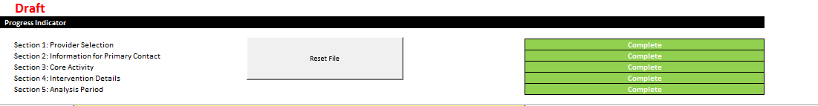
Core Activity & Intervention Questions
Q6 apparently only shows if you input a Provider Override Code (to be given by HHSC)
Q7 sets the date ranges:
  Operating period will default to a minimum of 3 years in duration
  Operating period, at a minimum, run to the end of DY9 (Sep. 30, 2020)
  Analysis may be a combination of retrospective and forecasted, depending on when startup period ended.
    Draft template, macros not in place to “force” a longer duration to get to that end of DY9 date
  Providers allowed to select interventions that were identified as beginning in DY10. Start up period must end before the end of DY10 – draft template will not allow an end date of 9/30/2021, but will allow one on on 9/29/2021
Once you complete Q7 – You will see all the task on the top of the tab will turn green and you can click on “Advance to Program Costs”

Slide 16
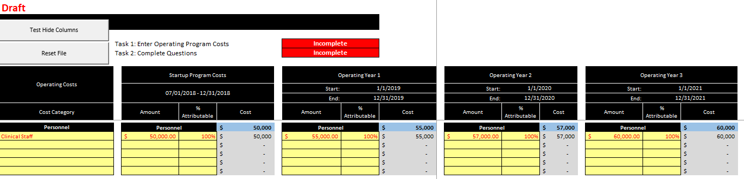
Program Costs
HHSC’s template has the same Cost Category buckets for all provider types:
Personnel
Training & Education
Office Operations
Technology
Facility
Equipment
Construction/Renovation
Other

Slide 17
Program Costs
TO THE BEST OF YOUR ABILITY:
For all but Construction/Renovation and Other, the categories have dropdowns to select for the line items.
  If you have more than 5 line items for everything except Other, additional rows will pop open.
Insert your startup costs for each line item.
Insert the allocation percentage of that cost to the intervention (i.e., how much of the costs are linked to the intervention being assessed).
  Note that the draft template allows allocation to be greater than 100% ‐ HHSC is aware of issue.
For each operating year, list costs and attributable percentages for each line item. If the operating year is being forecast, make sure that you can defend where the calculations came from.
Notes:
TO THE BEST OF YOUR ABILITY:
For all but Construction/Renovation and Other, the categories have dropdowns to select for the line items.
If you have more than 5 line items for everything except Other, additional rows will pop open.
Insert your startup costs for each line item.
Insert the allocation percentage of that cost to the intervention (i.e., how much of the costs are linked to the intervention being assessed).
Note that the draft template allows allocation to be greater than 100% ‐ HHSC is aware of issue.
For each operating year, list costs and attributable percentages for each line item. If the operating year is being forecast, make sure that you can defend where the calculations came from.

Slide 18
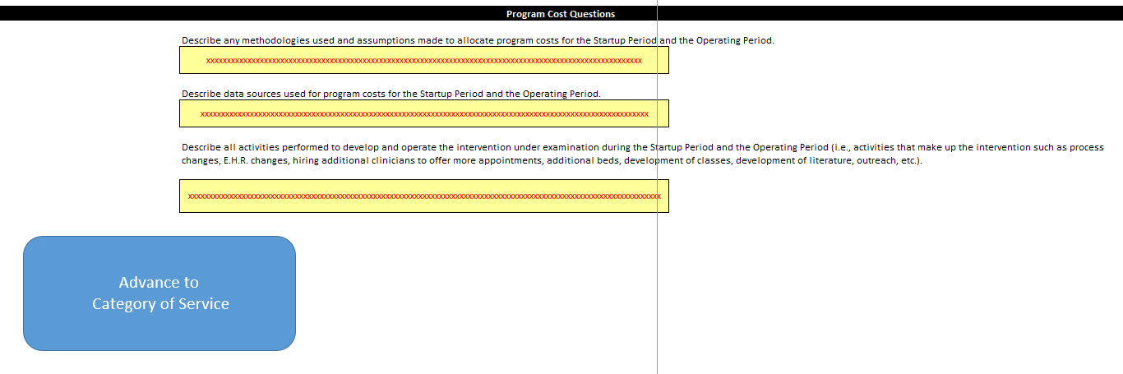
Program Costs
TO THE BEST OF YOUR ABILITY:
Describe your Assumptions. Be very detailed in this response.
Identify your data sources.
Clarify what activities are being described in the line items of the worksheet.
When finished click on “Advance to Category of Service”
Notes:
TO THE BEST OF YOUR ABILITY:
Describe your Assumptions. Be very detailed in this response.
Identify your data sources.
Clarify what activities are being described in the line items of the worksheet.
When finished click on “Advance to Category of Service”

Slide 19
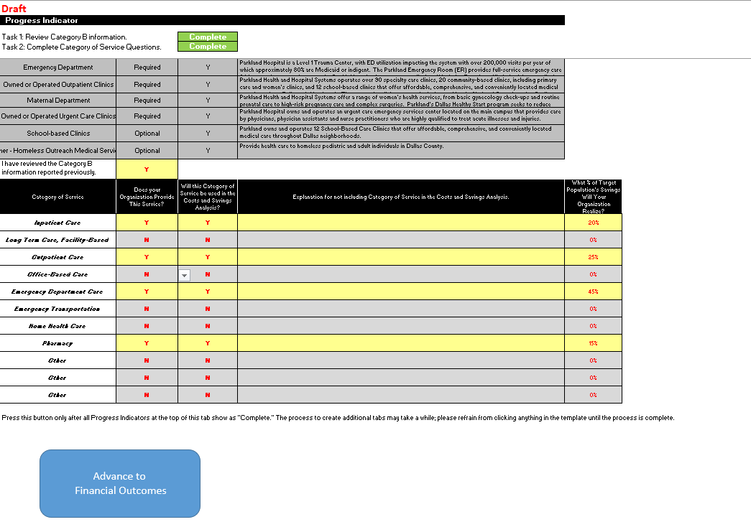
Category of Service
Validate the contents of your organization’s Category B business components (System Definition)
  Template will not generate next tab until Category B is reviewed.
Select which categories of service are being included in the analysis
  Categories are the same for all provider types.
  If you identify Yes your organization does have a service and select No for inclusion in the analysis, you will need to explain why.
  Also you will need to estimate the percentage of the savings for the target population by Category of Service the intervention may have.
Click on “Advance to Financial Outcomes”
Notes:
Validate the contents of your organization’s Category B business components (System Definition)
Template will not generate next tab until Category B is reviewed.
Select which categories of service are being included in the analysis
Categories are the same for all provider types.
If you identify Yes your organization does have a service and select No for inclusion in the analysis, you will need to explain why.
Also you will need to estimate the percentage of the savings for the target population by Category of Service the intervention may have.
Click on “Advance to Financial Outcomes”

Slide 20
Financial Outcomes
Answer the Guiding questions first – this will drive how the calculations will be done. It’s up to you how to approach this.
  Enter outcomes directly (YES) or calculate outcomes based on changes in cost (NO)
  Would you like to enter figures per eligible receiving person (YES) or in aggregate (NO)?
Notes:
Answer the Guiding questions first – this will drive how the calculations will be done. It’s up to you how to approach this.
Enter outcomes directly (YES) or calculate outcomes based on changes in cost (NO)
Would you like to enter figures per eligible receiving person (YES) or in aggregate (NO)?

Slide 21
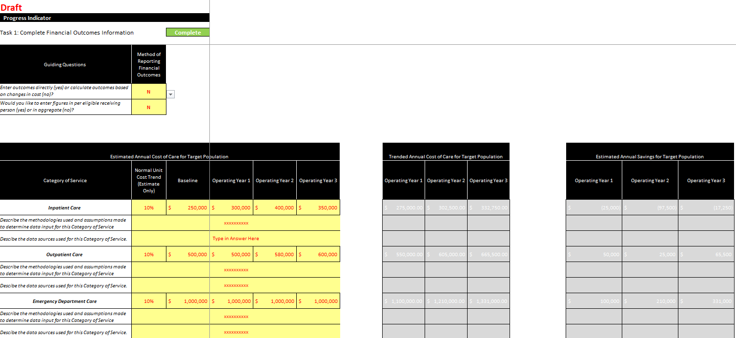
Financial Outcomes – Example 1
If you opt to calculate outcomes based on changes in cost, you will be asked to enter both the Normal Unit Cost Trend estimate, as well as the Baseline costs.
Notes:
If you opt to calculate outcomes based on changes in cost, you will be asked to enter both the Normal Unit Cost Trend estimate, as well as the Baseline costs.

Slide 22
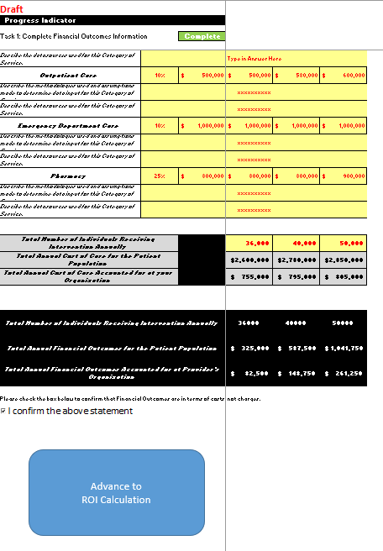
Financial Outcomes – Example 2
If you opt to enter outcomes directly, you will be asked to enter estimated annual savings for each Operating Year in the Categories of Service your organization is using.
Be prepared to clearly explain the methodologies and assumptions – this is where you make your case as to why your analysis is valid.
Confirm the above statements, click on “Advance to ROI Calculation”
Notes:
If you opt to enter outcomes directly, you will be asked to enter estimated annual savings for each Operating Year in the Categories of Service your organization is using.
Be prepared to clearly explain the methodologies and assumptions – this is where you make your case as to why your analysis is valid.
Confirm the above statements, click on “Advance to ROI Calculation”
Note if you choose this option: There is a issue in the template – to get around it for now, go back up to the Guiding Questions, Click N on the first question (your values will stay in your fields), go to the bottom of the page and click the I confirm statement, then go back up and click Y again on the first question, it will leave the blue box available to click to the next section.

Slide 23
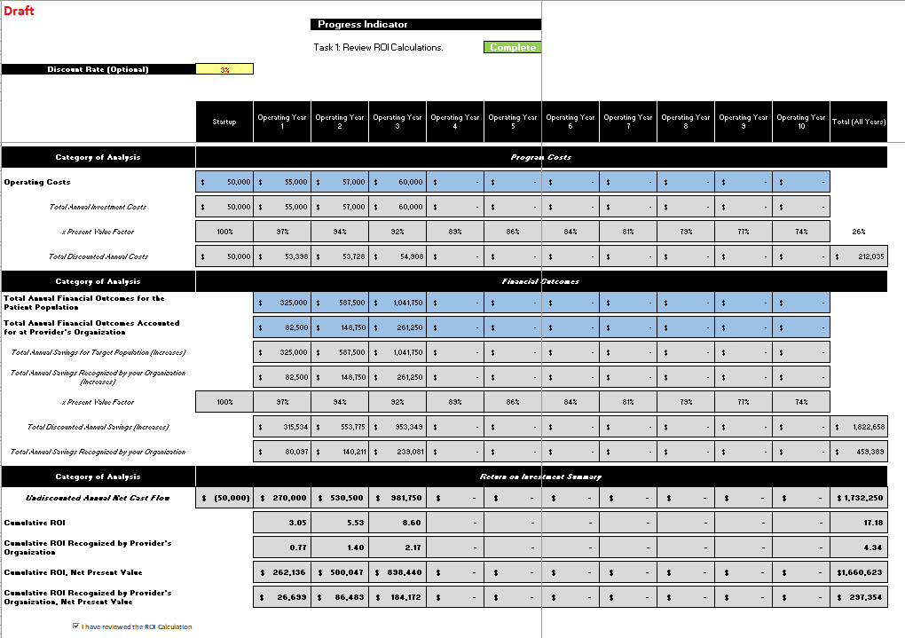
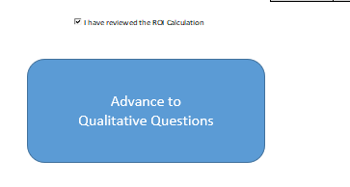
ROI Calculation
Discount Rate is optional
Everything else on this tab will autocalculate
You will use this information to answer the questions on the next tab, click on “Advance to Qualitative Questions”
Notes:
Discount Rate is optional
Everything else on this tab will autocalculate
You will use this information to answer the questions on the next tab, click on “Advance to Qualitative Questions”

Slide 24
ROI Calculation
The ROI information reflects the information you enter.
There is NO penalty for a negative ROI calculation.
  HHSC’s deliverable wants an honest assessment of how the intervention being reviewed has done from a financial standpoint.
Notes:
The ROI information reflects the information you enter.
There is NO penalty for a negative ROI calculation.
HHSC’s deliverable wants an honest assessment of how the intervention being reviewed has don from a financial standpoint.

Slide 25
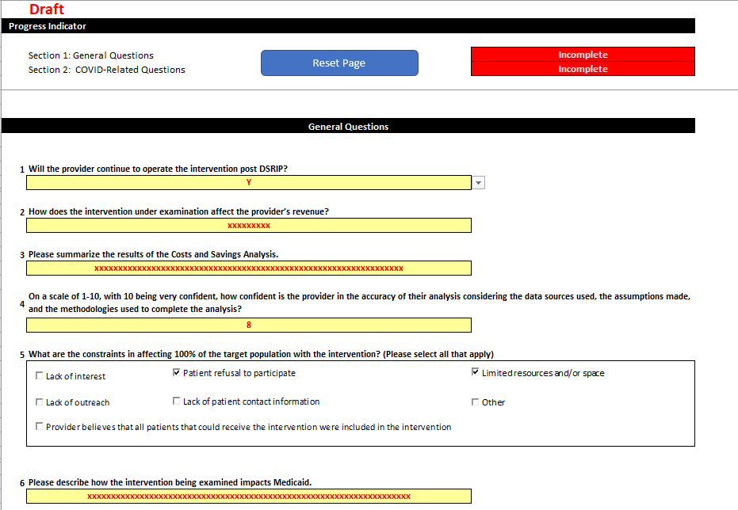
Qualitative Questions
Notes:
If you answer Yes

Slide 26
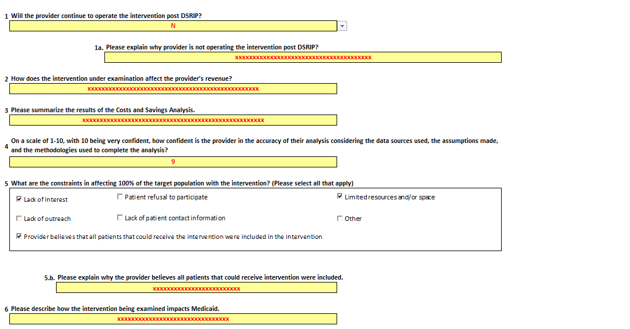
Qualitative Questions
Notes:
If you answer No

Slide 27
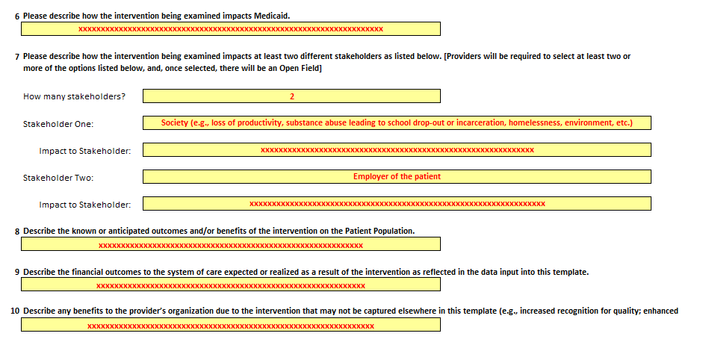
Qualitative Questions

Slide 28
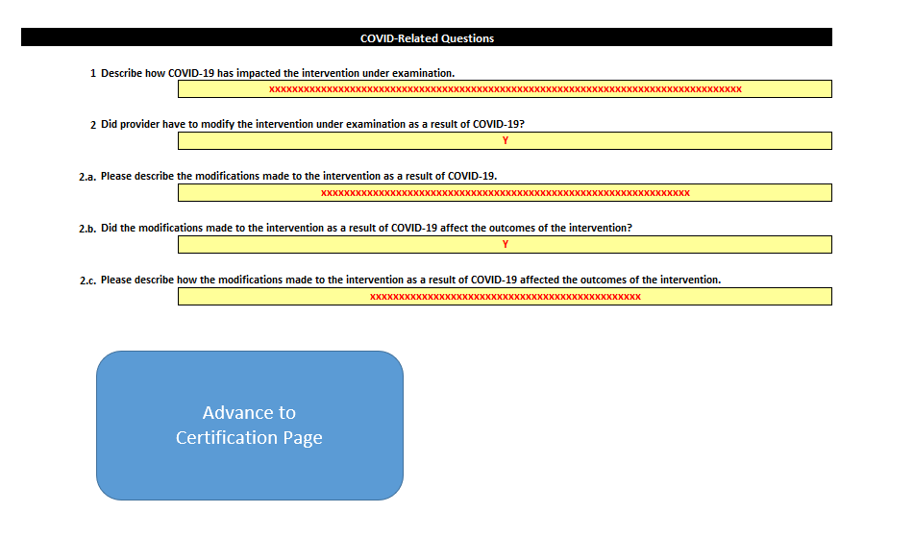
Qualitative Questions

Slide 29
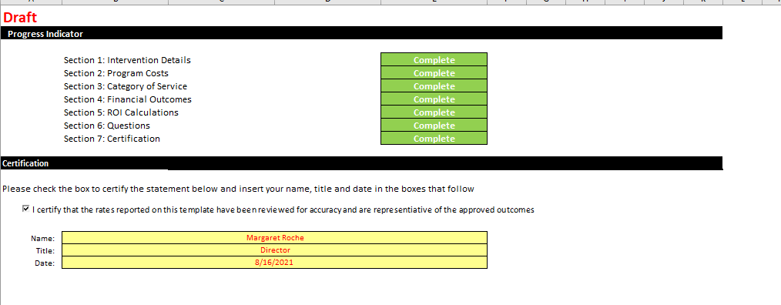
Certification Page

Slide 30

Questions

Slide 31
Anchor Contacts
RHP 9
Margie Roche, margaret.roche@phhs.org, 214.490.0416
RHP 10
Nisha Patel, npatel09@jpshhealth.org, 817.702.6850
RHP 18
des Anges Cruser, desAnges@pciprocompsolutions.org, 817.223.7324
Leigh Hornsby, leigh@piacommunications.com

